Slide 1
P
P O L Y M E C H
MONtelli cutlery

Slide 2
SHEER 18|10 Stainless Steel

Slide 3
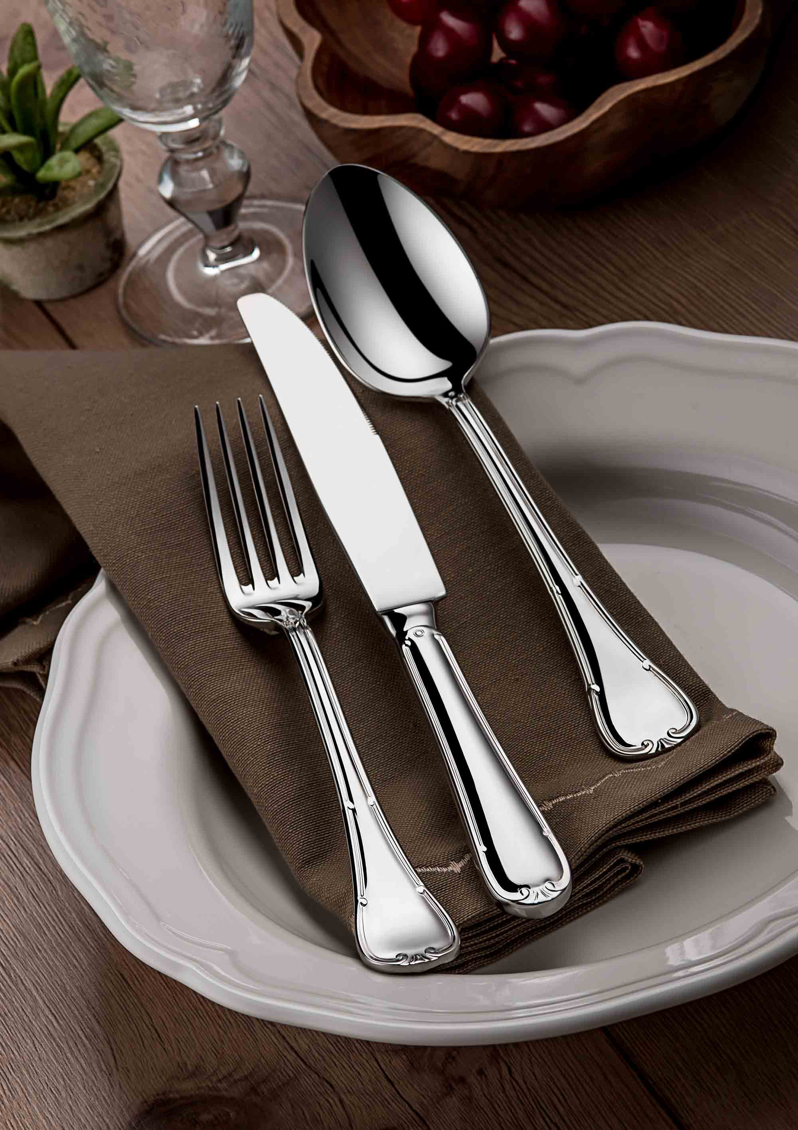
Ruban 18|10 Stainless Steel

Slide 4
Contour

Slide 5
Linea-1005 18|10 Stainless Steel

Slide 6
Romarino 18|10 Stainless Steel

Slide 7
Baguette 18|10 Stainless Steel

Slide 8
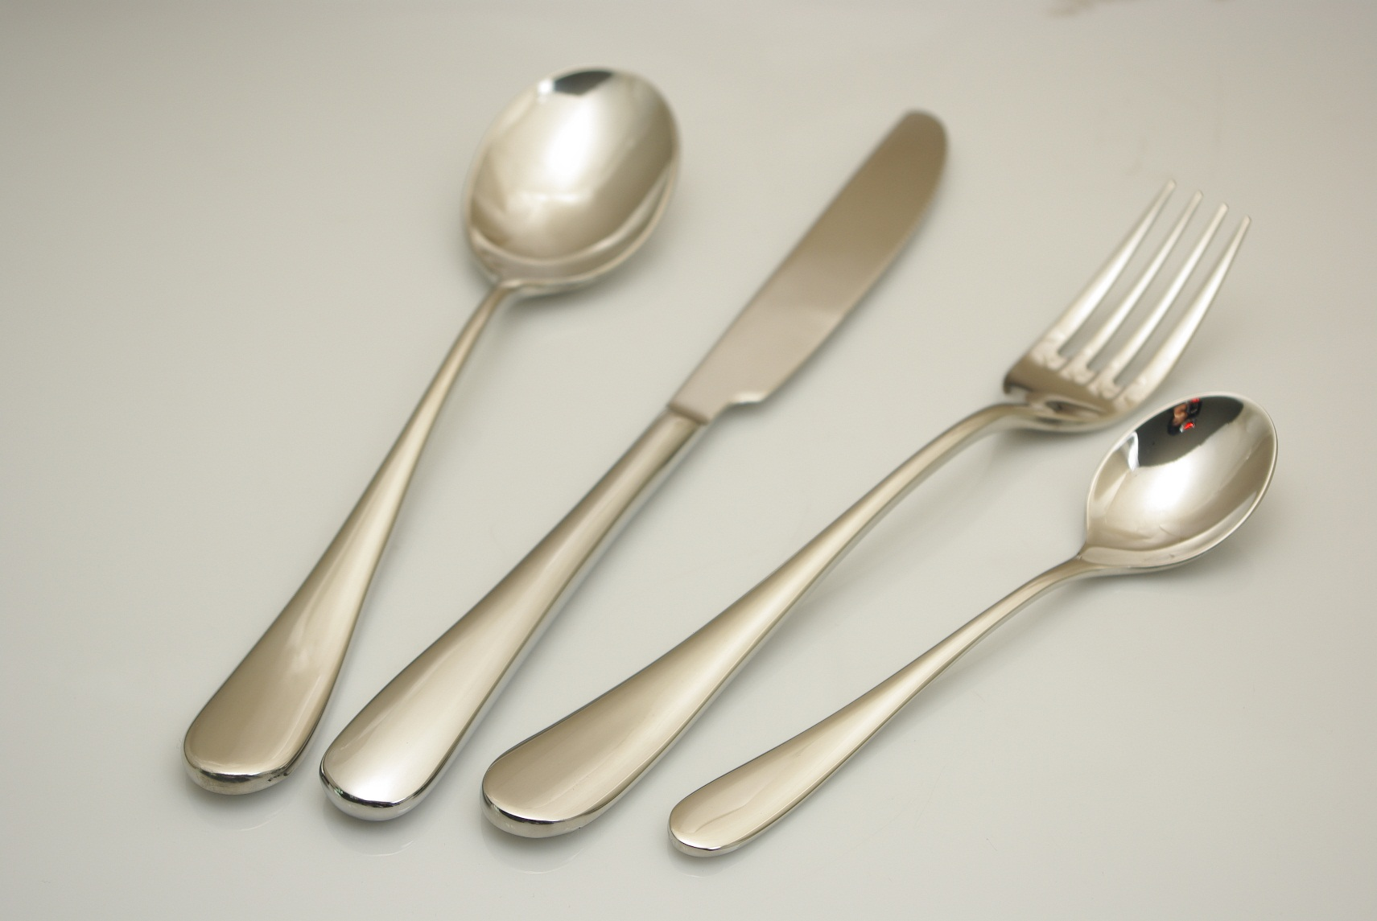
Focus 18|10 Stainless Steel

Slide 9
Silhouette 18|10 Stainless Steel

